Slide 1



Slide 2
TEAM & SUPERVISION
Supervisor
ENG. Ahmad Herafi
Team
ENG. Mahmoud Bazzi
2

Slide 3

Outline
01.
01.
02.
03.
01.
Introduction
Related Works
System Analysis
04.
05.
System Design
Conclusion
Introduction
3

Slide 4
01.
Introduction
4

Slide 5
01.
Introduction
An application that connects users' needs with the best professional expertise.
5

Slide 6

Outline
01.
02.
03.
Introduction
Related Works
System Analysis
04.
05.
System Design
Conclusion
02.
02.
Related Works

Slide 7


02.
Related Works
6

Slide 8
Points of
comparison
Social Media Integration
No Platform Middleman Fees
Visual Portfolios & Offers
Booking & Scheduling System
Direct Contact
Service Ratings
systems
7

Slide 9
Outline
01.
02.
03.
Introduction
Related Works
System Analysis
04.
05.
System Design
Conclusion
03.
System Analysis

Slide 10

03.
System Analysis
8

Slide 11
Use Case
`
9

Slide 12
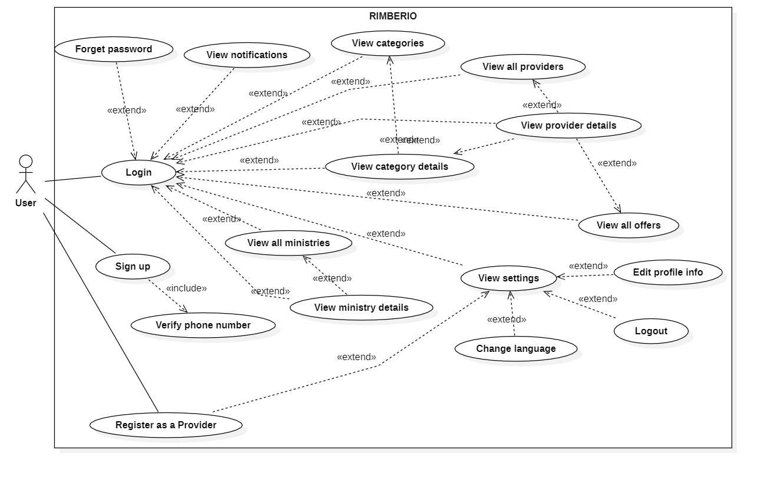
User Use Case
`
10

Slide 13
User Use Case
`

Slide 14
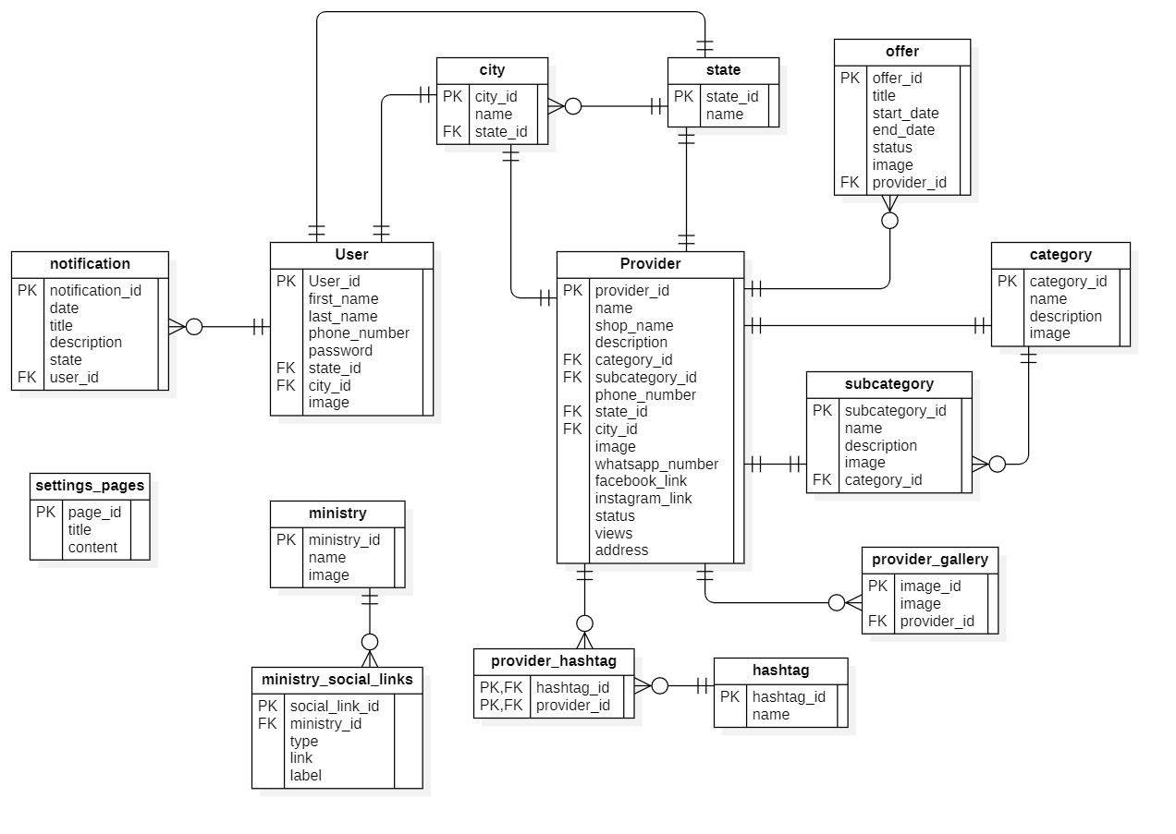
ERD
`
11

Slide 15
User Use Case
`
12

Slide 16
Outline
01.
02.
03.
Introduction
Related Works
System Analysis
04.
05.
04.
System Design
Conclusion
System Design

Slide 17

04.
System Design
13

Slide 18
System Architecture
View
UI
ViewModel
GetX
Model
Data Models
Widgets
API
14

Slide 19
Outline
01.
02.
03.
Introduction
Related Works
System Analysis
04.
05.
System Design
Conclusion
05.
Conclusion

Slide 20

05.
Conclusion
15

Slide 21
Difficulties
API Integration & Cross-Team Communication Gap
High-Fidelity UI Implementation
16

Slide 22
Future Works
In-App Real-Time Messaging
Interactive Maps & Navigation
17

Slide 23
Future Works
Advanced Booking & Scheduling System
AI-Powered Service Recommendations
18

Slide 24
Future Works
Independent App for service provider
Rating And Review
19

Slide 25
Thank You
For Listening

